Slide 1
Analyzing the Drivers of Corporate Financial Resilience
Shyam Sankar

Slide 2
Motivation
Economic shocks are becoming more frequent and unpredictable, making resilience a critical competitive advantage.
Companies across industries respond differently to the same macro conditions, some withstand disruptions, while others struggle.
Financial ratios like liquidity, leverage, and profitability offer clues, but their behavior changes dramatically across economic cycles.
FP&A teams need clear insights into how external conditions shape internal financial strength.
By analyzing 2009–2023, a period filled with crises, recoveries, and rapid shifts, we can uncover what truly drives corporate resilience.

Slide 3
Key Economic Periods Covered (2009–2023)
Post–Financial Crisis Recovery
A slow rebuild phase where companies focused on restoring liquidity and stability after the 2008 crash.
Late-Decade Stability
A period of steady economic conditions with predictable interest rates and healthy corporate performance.
Inflation & Rising Rates
Soaring inflation and aggressive rate hikes created renewed financial strain and tightened liquidity conditions.
2013
2019
2023
2009
2016
2021
Mid-Decade Expansion & Commodity Shocks
Growth resumed, but global oil and commodity price swings created pockets of volatility across industries.
COVID-19 Shock & Aftermath
The pandemic caused an abrupt economic collapse followed by an unusually fast recovery powered by stimulus.

Slide 4
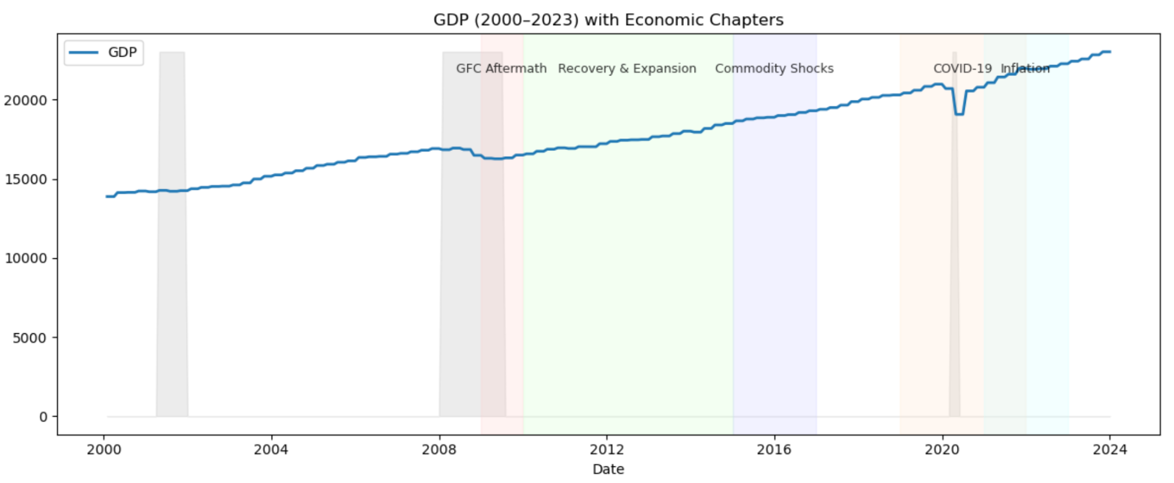
Gross Domestic Product (GDP)
Gross Domestic Product (GDP) measures the total economic output of a country, reflecting overall economic health and growth trends.
Notes:
The graph shows generally steady growth from 2009–2022, with small dips corresponding to the post-financial crisis recovery and the COVID-19 shock, highlighting periods where companies faced heightened external pressures.

Slide 5
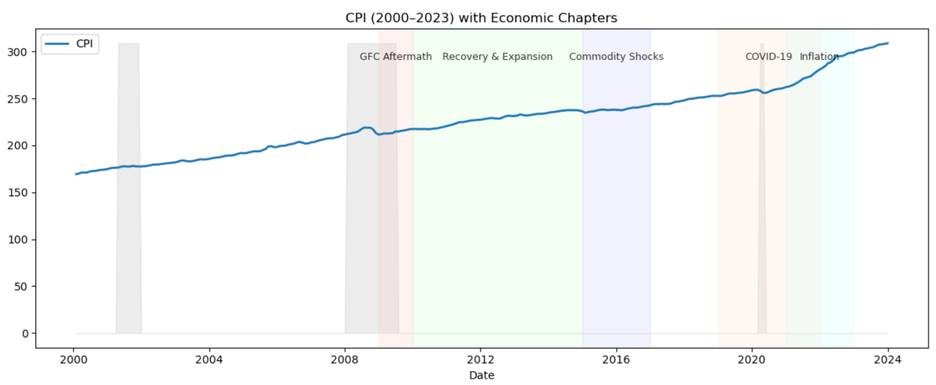
Consumer Price Index (CPI)
The Consumer Price Index (CPI) tracks changes in the price level of a basket of goods and services, reflecting inflationary pressures in the economy.

Slide 6
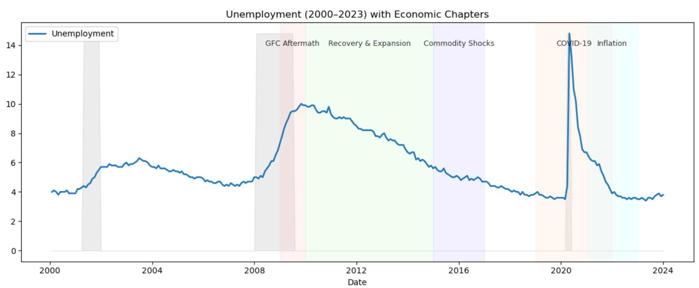
Unemployment Rate
The unemployment rate measures the percentage of the labor force that is jobless and actively seeking work, reflecting labor market health.
Notes:
Unemployment spikes in the aftermath of the GFC, gradually declines during the recovery and expansion periods, and rises again sharply during the COVID-19 shock, highlighting the labor market stresses companies had to navigate.

Slide 7
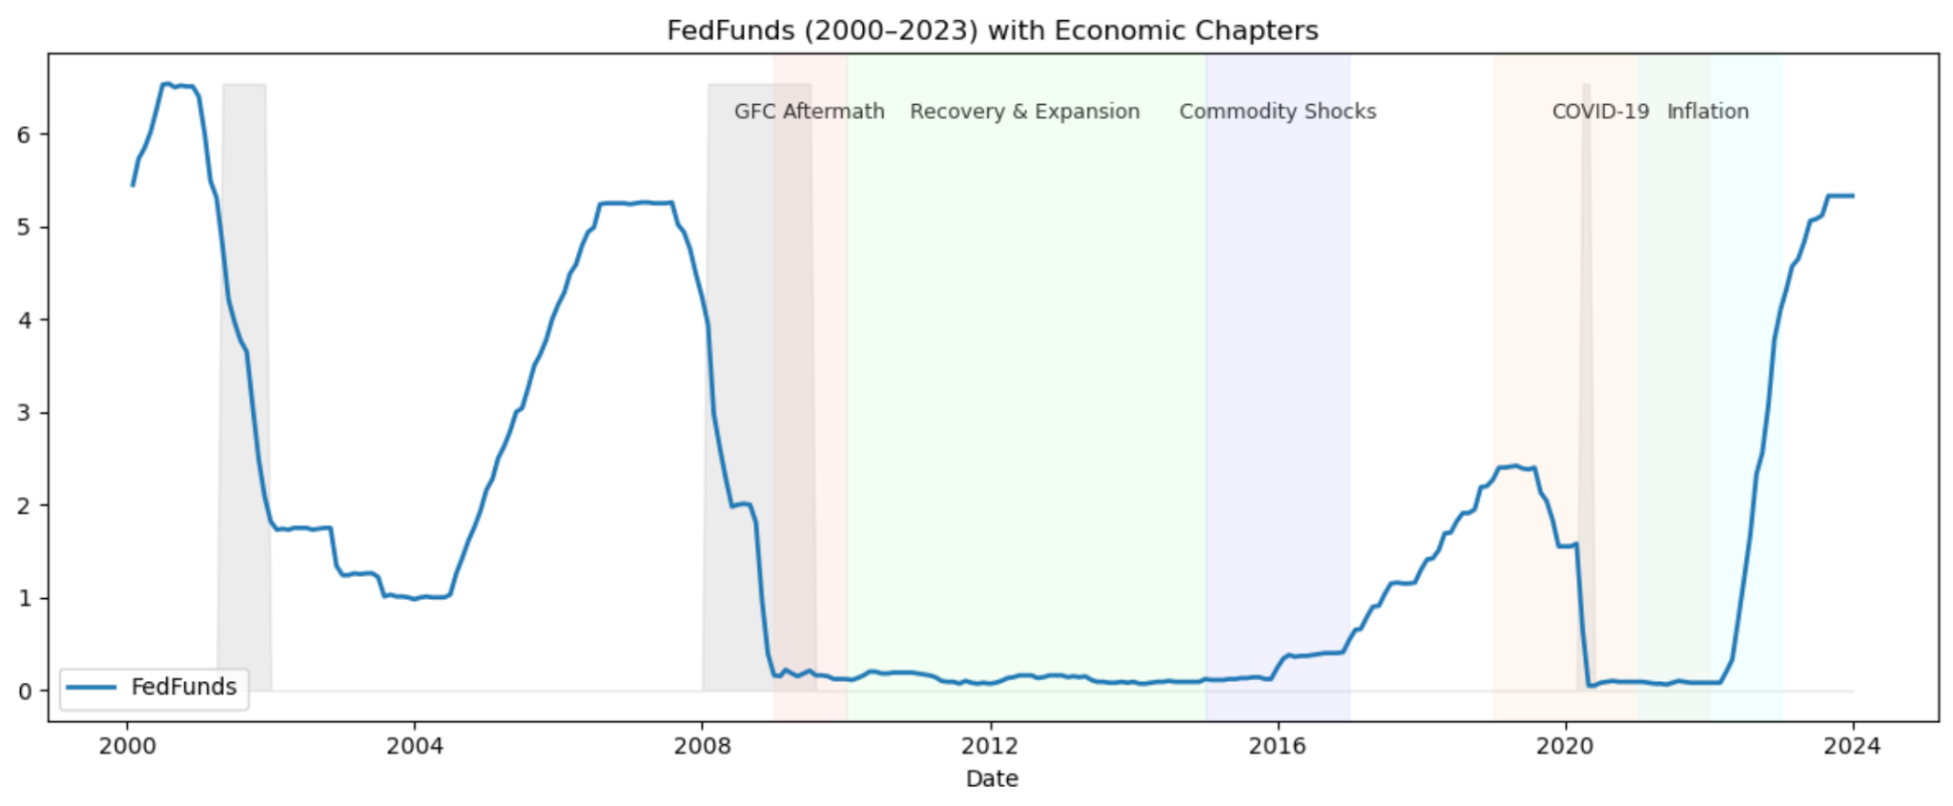
Federal Funds Rate
The Federal Funds Rate is the interest rate at which banks lend to each other overnight, guiding overall borrowing costs in the economy.
Notes:
The rate drops sharply after the GFC, stays low through the recovery, rises modestly during commodity shocks, falls again during COVID-19, and then climbs post-pandemic amid inflationary pressures, shaping corporate borrowing and liquidity strategies.

Slide 8
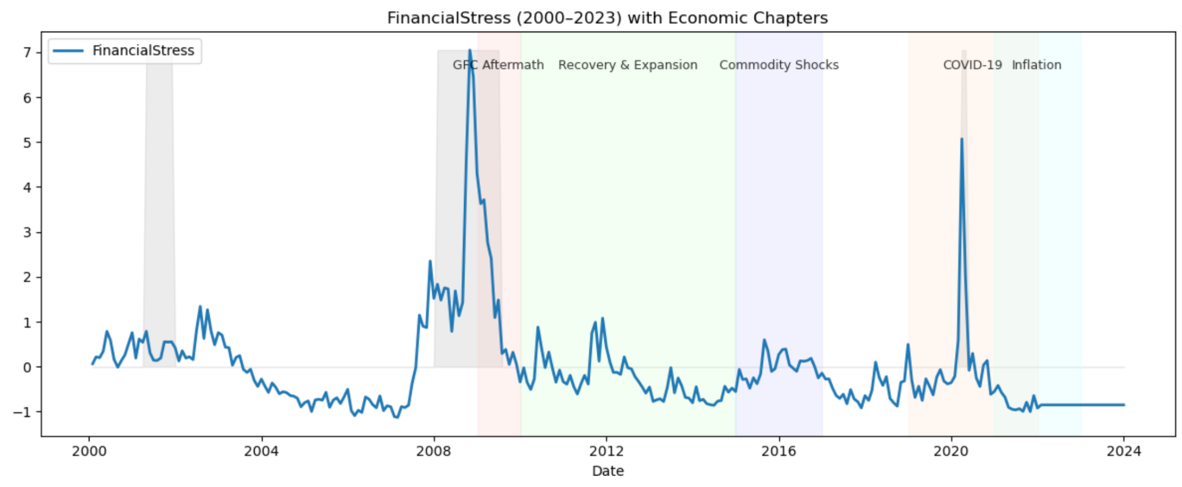
Financial Stress Index
The Financial Stress Index measures disruptions and instability in the financial system, capturing market volatility, liquidity shortages, and credit conditions.
Notes:
Financial stress peaks during the post-GFC recession and the COVID-19 shock, highlighting periods when companies faced heightened external financial pressures and needed robust resilience strategies.

Slide 9
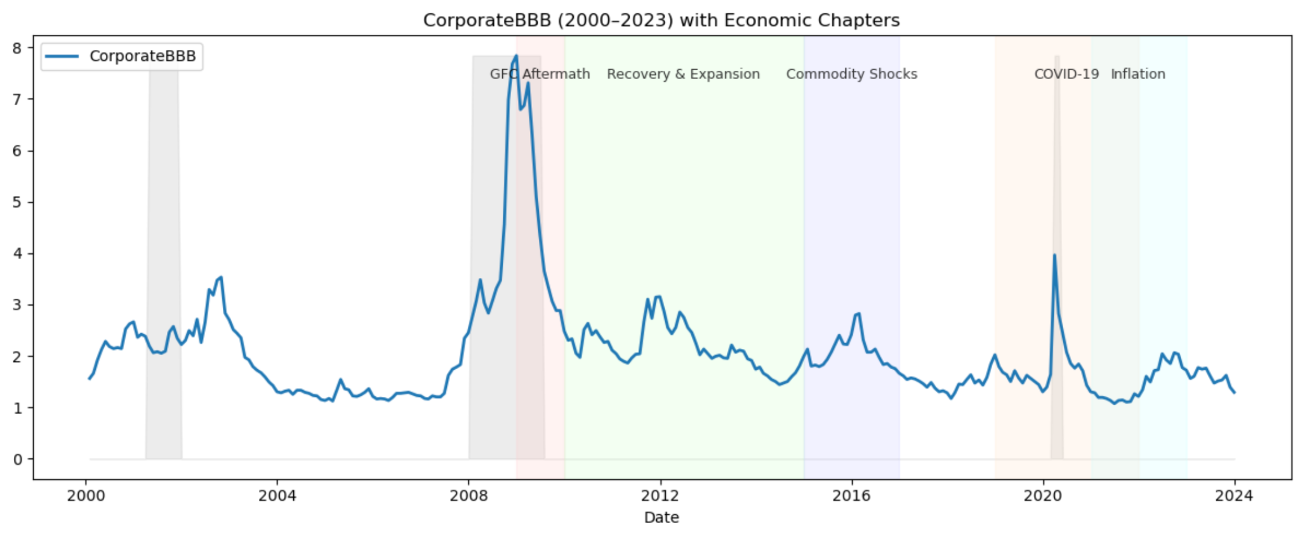
Corporate BBB Credit Spreads
BBB credit spreads reflect the extra yield investors demand to hold lower-rated investment-grade corporate debt, indicating perceived credit risk.
Notes:
BBB refers to a credit rating assigned to corporate bonds by rating agencies like S&P, Fitch, and Moody’s.
The BBB corporate bond spread reflects how risky the market thinks corporate debt is.

Slide 10
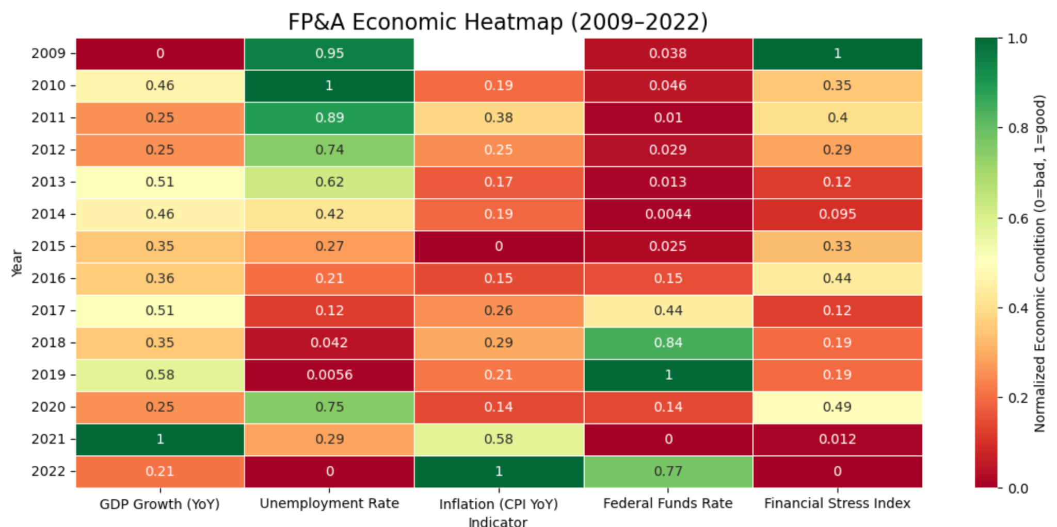
Summary

Slide 11
Industry Liquidity Analysis
To understand how different sectors withstand economic shocks, we begin by examining key liquidity ratios, which indicate a company’s ability to meet short-term obligations.
Quick Ratio Measures how well a firm can cover its short-term liabilities using only its most liquid assets, cash, receivables, and marketable securities.
Current Ratio Assesses overall short-term financial health by comparing all current assets to current liabilities.
These ratios help reveal how prepared industries like Crop Production, Software, and Real Estate are to handle sudden disruptions in cash flow or economic uncertainty.
Notes:
Current Ratio
Includes all current assets (cash, receivables, inventory, etc.).
Quick Ratio
Includes only the most liquid assets (cash + marketable securities + receivables).

Slide 12
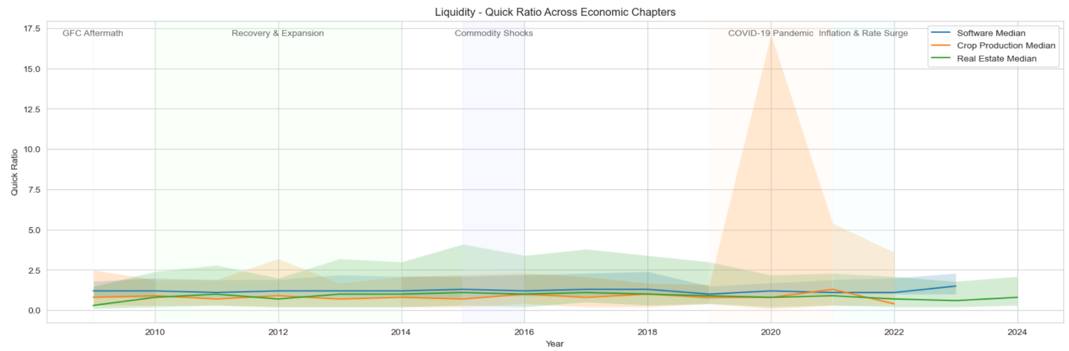
Quick Ratio
Over 15 years, Computers/Tech consistently maintained the strongest quick ratio (~1.1–1.25 median), while Real Estate and Crops repeatedly fell into sub-1.0 territory during every major shock.
Notes:
Over 15 years, Computers/Tech consistently maintained the strongest quick ratio (~1.1–1.25 median), while Real Estate and Crops repeatedly fell into sub-1.0 territory during every major shock

Slide 13
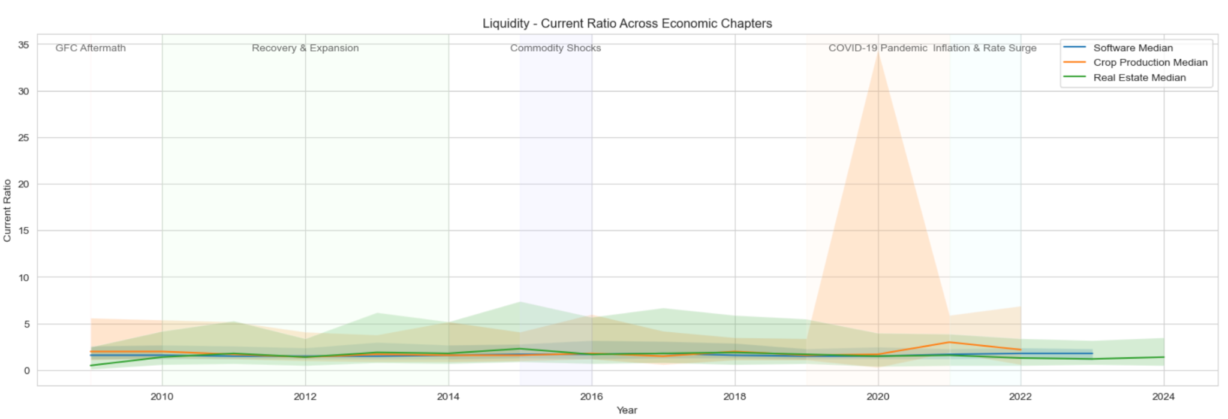
Current Ratio
Crops/Agriculture repeatedly showed the strongest current ratio (often >2.0) through every crisis, while Real Estate was the most fragile — collapsing below 1.0 in the GFC and slipping again when rates rose.

Slide 14
Industry Leverage Analysis
To evaluate the long-term financial stability of each sector, we examine key leverage ratios, which show how heavily an industry relies on debt to finance its operations.
Total Liabilities / Net Worth (%) Indicates overall financial leverage by comparing all liabilities to shareholders’ equity. Higher values suggest increased risk and dependence on borrowed capital.
Current Liabilities / Net Worth (%) Measures short-term leverage by showing how much of a company’s equity is covered by near-term obligations.
These ratios highlight the capital structure pressures faced by Crop Production, Software, and Real Estate, helping us understand which industries are more vulnerable during periods of economic stress.

Slide 15
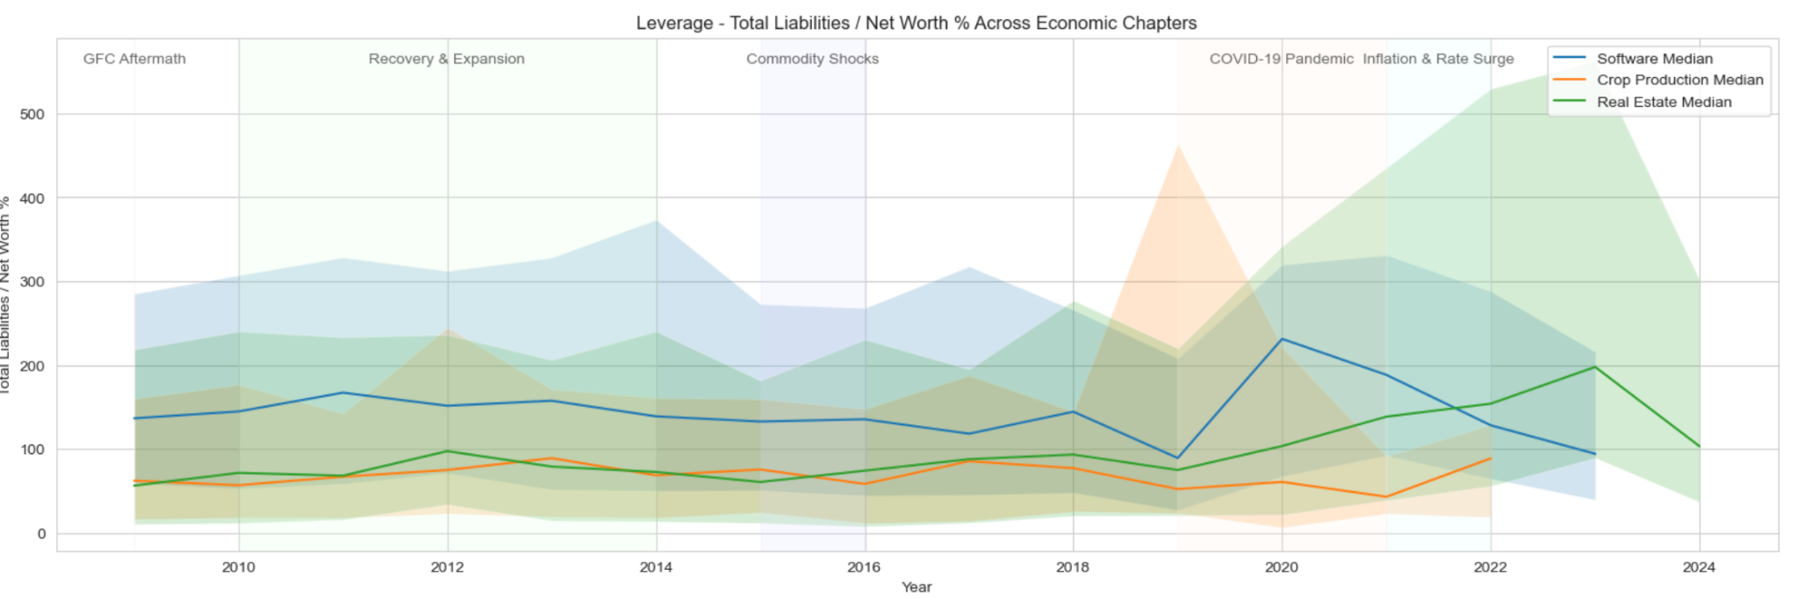
Total Liabilities / Net Worth (%)
Real Estate and especially Crops repeatedly piled on debt during every “good times” phase and entered each new crisis with the highest leverage, while Tech/Computers consistently operated with more moderate (though still high) debt-to-equity levels.

Slide 16
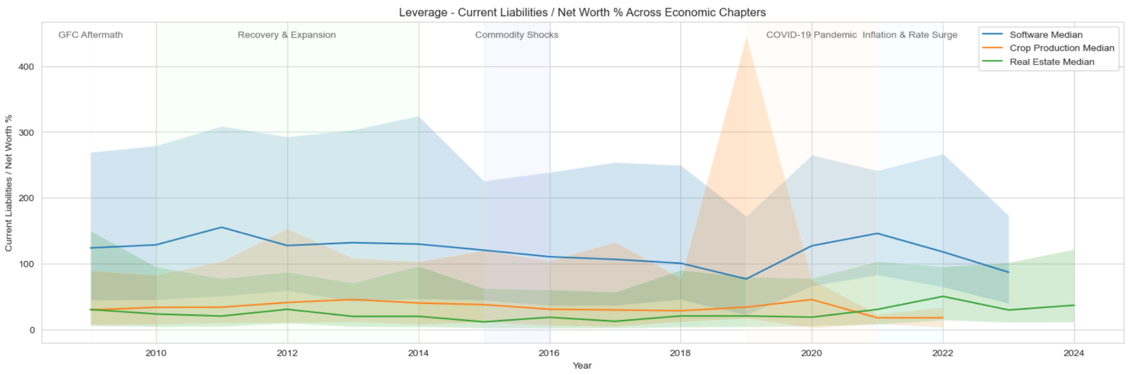
Current Liabilities / Net Worth (%)
Crops/Agriculture repeatedly swings from the lowest to the highest short-term leverage in every cycle, Computers live permanently around 130% (structural), and Real Estate opportunistically loads and unloads short-term debt depending on the property cycle.

Slide 17
Efficiency Ratios
To assess how efficiently each sector runs its operations, we analyze key efficiency ratios that show how well industries convert assets and inventory into revenue.
Collection Period (days) Indicates how quickly companies collect payments. Lower values show faster cash flow; higher values suggest slower collections and potential liquidity pressure.
Assets / Sales (%) Measures asset efficiency. Lower percentages mean assets are being used effectively; higher values point to underutilization.
Sales / Inventory (times) Shows how fast inventory is sold. Higher turnover reflects strong demand and efficient management; lower turnover suggests slower movement or excess stock.
These ratios highlight how operationally efficient Crop Production, Software, and Real Estate are, revealing which industries stay agile during economic stress.

Slide 18
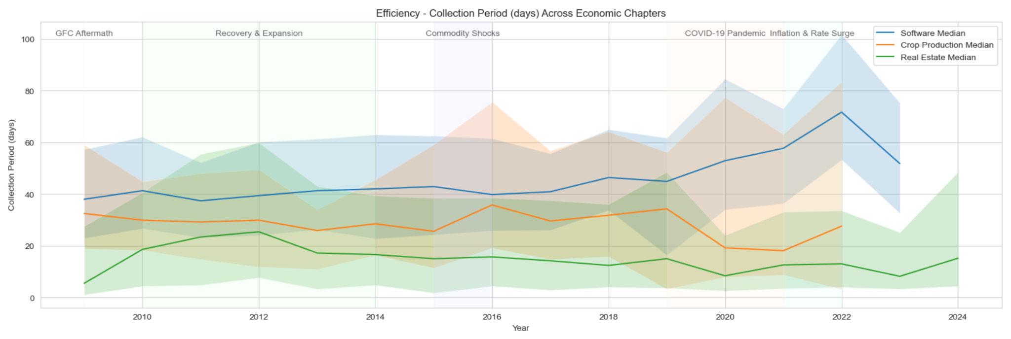
Collection Period (days):
Real Estate consistently collects in ~2 weeks or less in every environment, Crops hovers around one month, while Computers/Tech distributors have lived with 40-70 day terms for 15 years and got dramatically worse in every crisis.

Slide 19
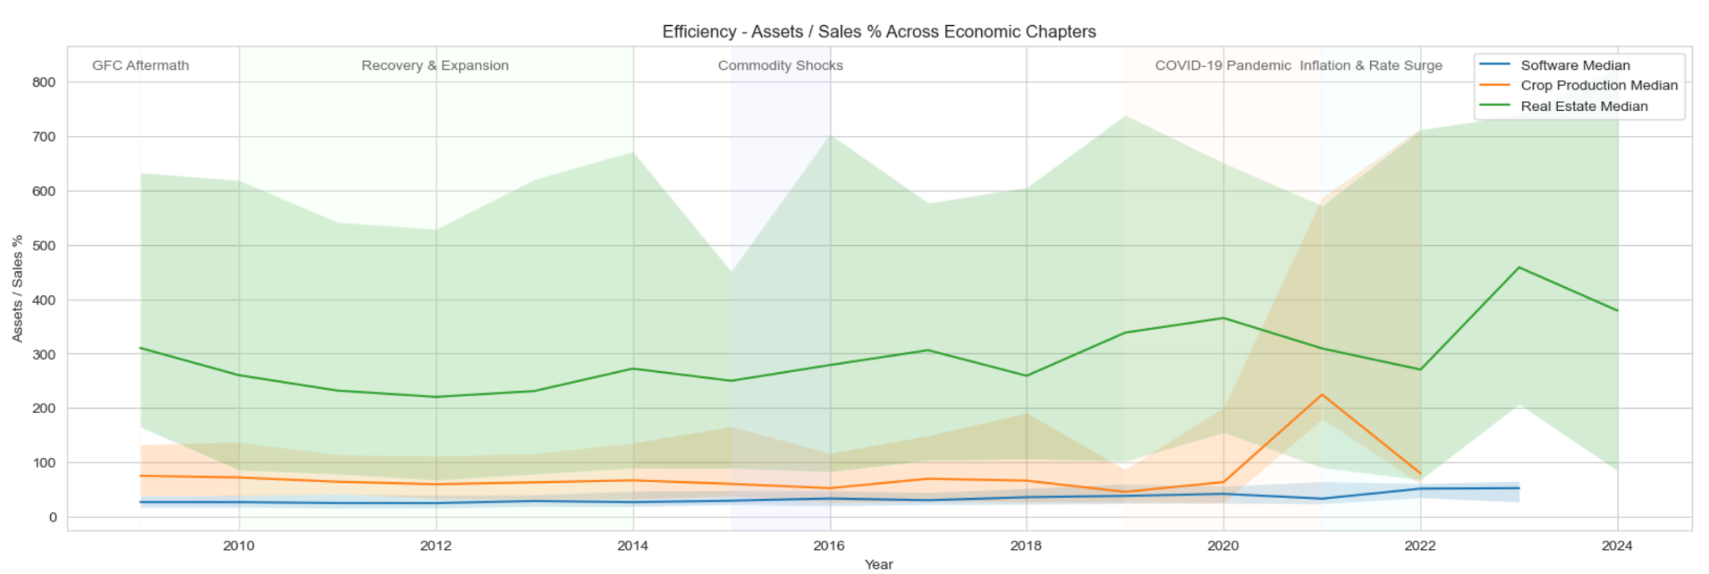
Assets / Sales %
Computers/Tech consistently dominated with sub-50% asset-to-sales, while Crops hovered 50-150% and Real Estate chronically >200%—proving asset-light models weather every cycle far better than capital-intensive ones.

Slide 20
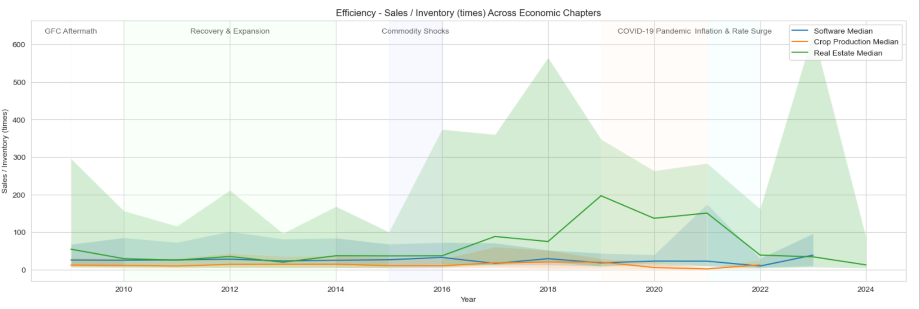
Sales / Inventory (times)
Real Estate dominated turnover (often 30-100x) through every cycle, Computers held reliable 18-29x, while Crops chronically lagged (7-14x) — proving low-inventory models like property outpace asset-heavy models in all environments.

Slide 21
Profitability Ratios
To understand the financial performance of each sector, we examine key profitability ratios that capture how well industries convert revenue and capital into earnings.
Net Profit Margin Measures how much profit is kept from each dollar of revenue, indicating overall cost control and pricing power.
Return on Assets (ROA) Shows how efficiently a company uses its asset base to generate profits.
Return on Equity (ROE) Indicates how effectively the firm uses shareholders’ equity to produce earnings, reflecting overall capital efficiency.
These ratios reveal which industries deliver stronger financial returns and how profitability shifts during different economic conditions.

Slide 22
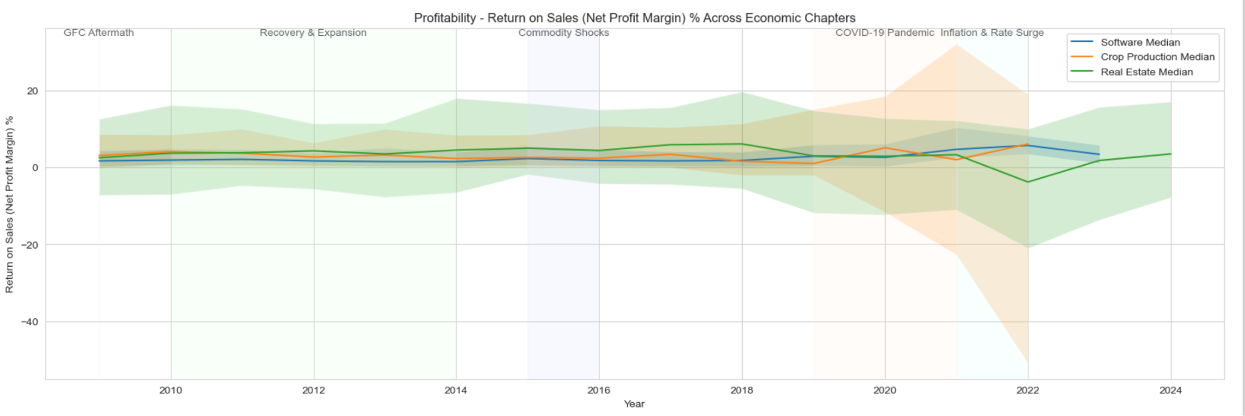
Net Profit Margin
Over the full cycle, Computers/Tech delivered the most consistent and crisis-resistant margins (always positive, peaking in shocks), Crops were volatile but survived, while Real Estate enjoyed fat margins in good times and got crushed the moment rates rose.

Slide 23
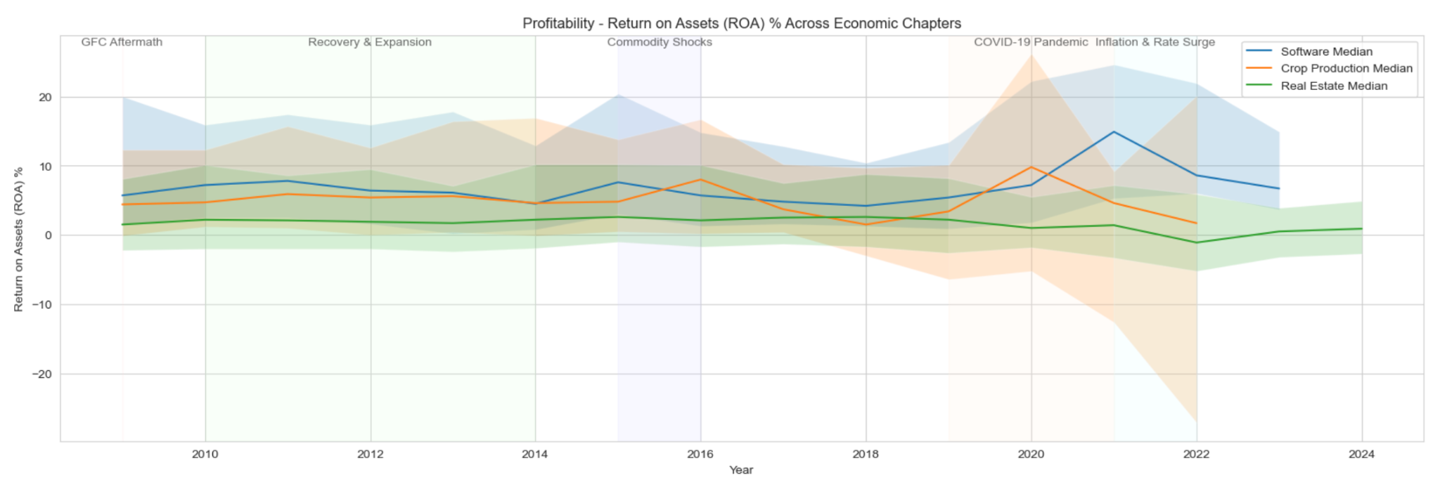
Return on Assets (ROA)
Computers/Tech delivered the highest and most resilient ROA in every single period (often 2–10× higher than the others), Crops stayed respectable except when commodity prices collapsed, while Real Estate languished below 2–3 % for most of the cycle and turned negative the moment interest rates rose.

Slide 24
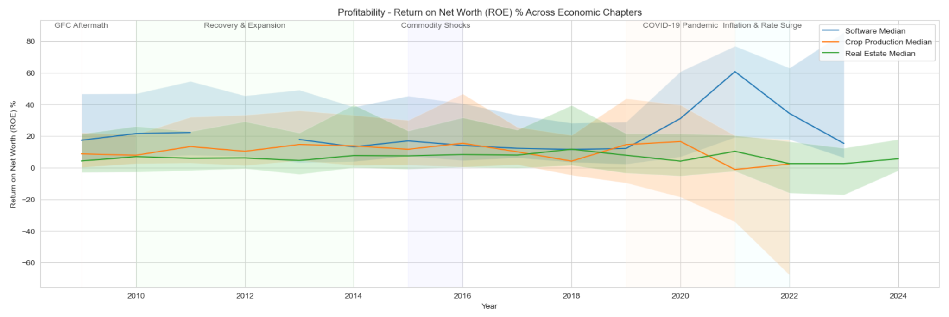
Return on Equity (ROE)
Computers/Tech owners enjoyed the highest, most stable, and most crisis-resistant ROE across the entire 15-year cycle (often 2–10× higher than the others), Crops swung wildly with commodity prices, and Real Estate delivered big ROE only when rates were low and crashed hardest whenever rates rose.

Slide 25
Period | Best-Performing Industry | Why it dominated (key drivers)
GFC Aftermath (2009) | Software/Computers | Highest Quick & Current ratios, strongest ROA (5.7%) and ROE (17.3%), moderate leverage, and still-positive margins while Real Estate was effectively insolvent and Crops was just surviving.
Recovery & Expansion (2010–2014) | Software/Computers | Consistently highest ROA (~6.4%) and ROE (~18–21%), solid liquidity, moderate leverage, and stable margins throughout the entire rebound; asset-light model compounded quietly while others were rebuilding balance sheets.
Commodity Shocks (2015–2016) | Software/Computers | Maintained highest ROA (~6.6%) and ROE (~18–20%), best Quick Ratio, stable leverage, and least affected by collapsing oil/grain prices; Crops got crushed on margins and leverage, Real Estate stayed sluggish.
COVID-19 Pandemic (2019–2021) | Software/Computers – decisive blowout | Exploded ROA (9–15%) and ROE (30–60%), margins jumped to 4–5%, turnover held up, and liquidity remained safe; the only sector that actually got stronger during lockdowns and remote-work boom. Real Estate had hot sales but still mediocre returns, Crops drowned in debt and low prices.
Inflation & Rate Surge (2021–2022) | Software/Computers – again clear winner | Highest ROA (~11–15%), ROE (~30–47%), and net margins (~5.5%); Quick Ratio held steady while Crops and Real Estate saw liquidity and margins collapse as rates rose. Tech’s low fixed-asset base and pricing power proved bullet-proof against inflation and tightening.

Slide 26
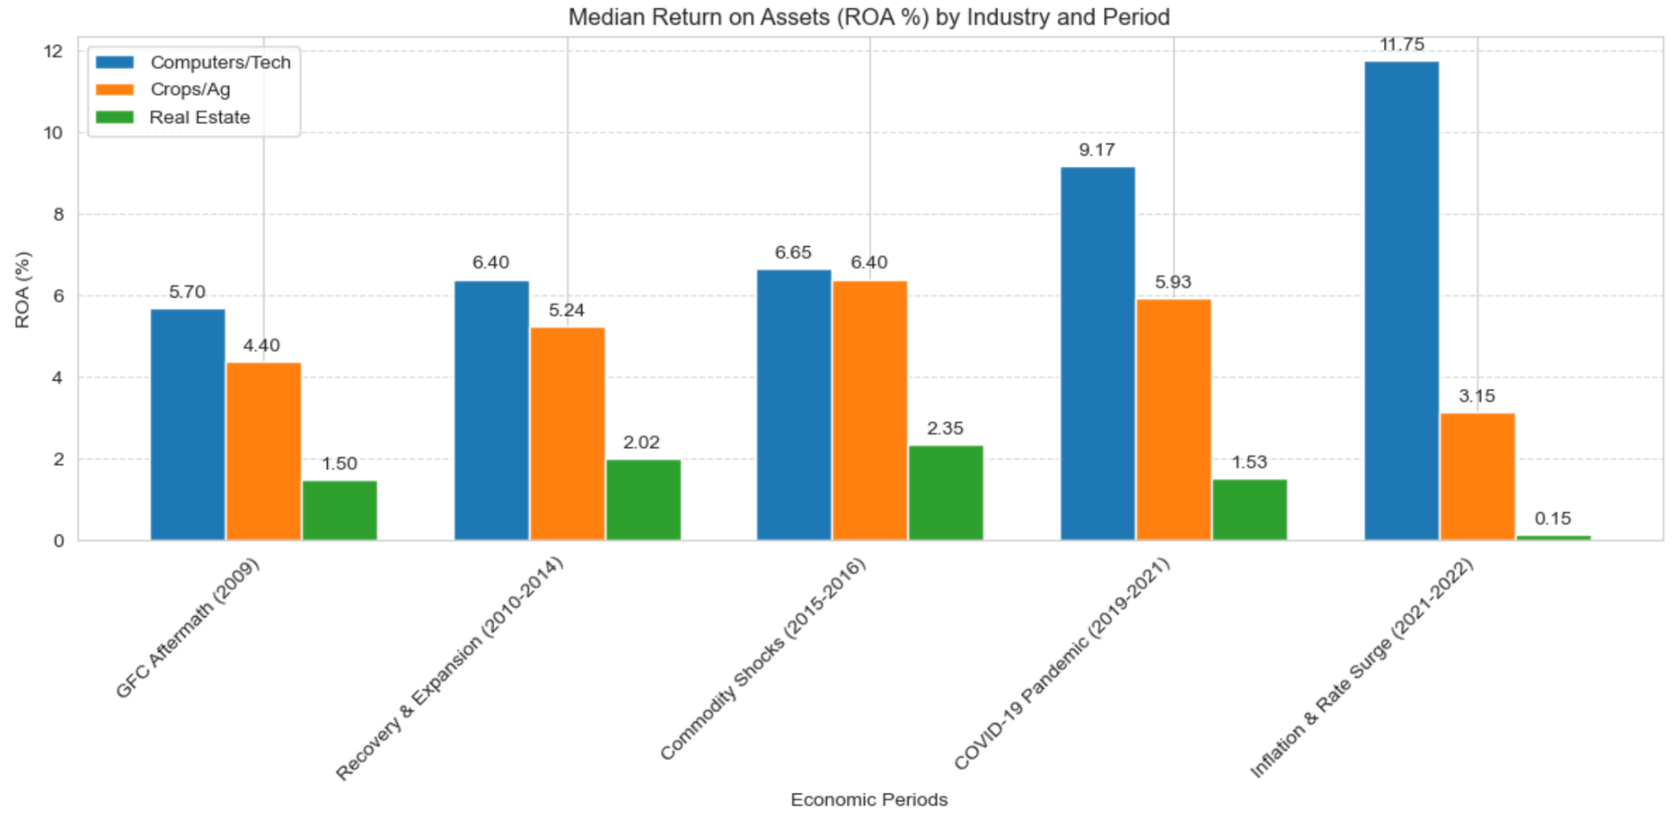
Return on Assets (ROA)

Slide 27
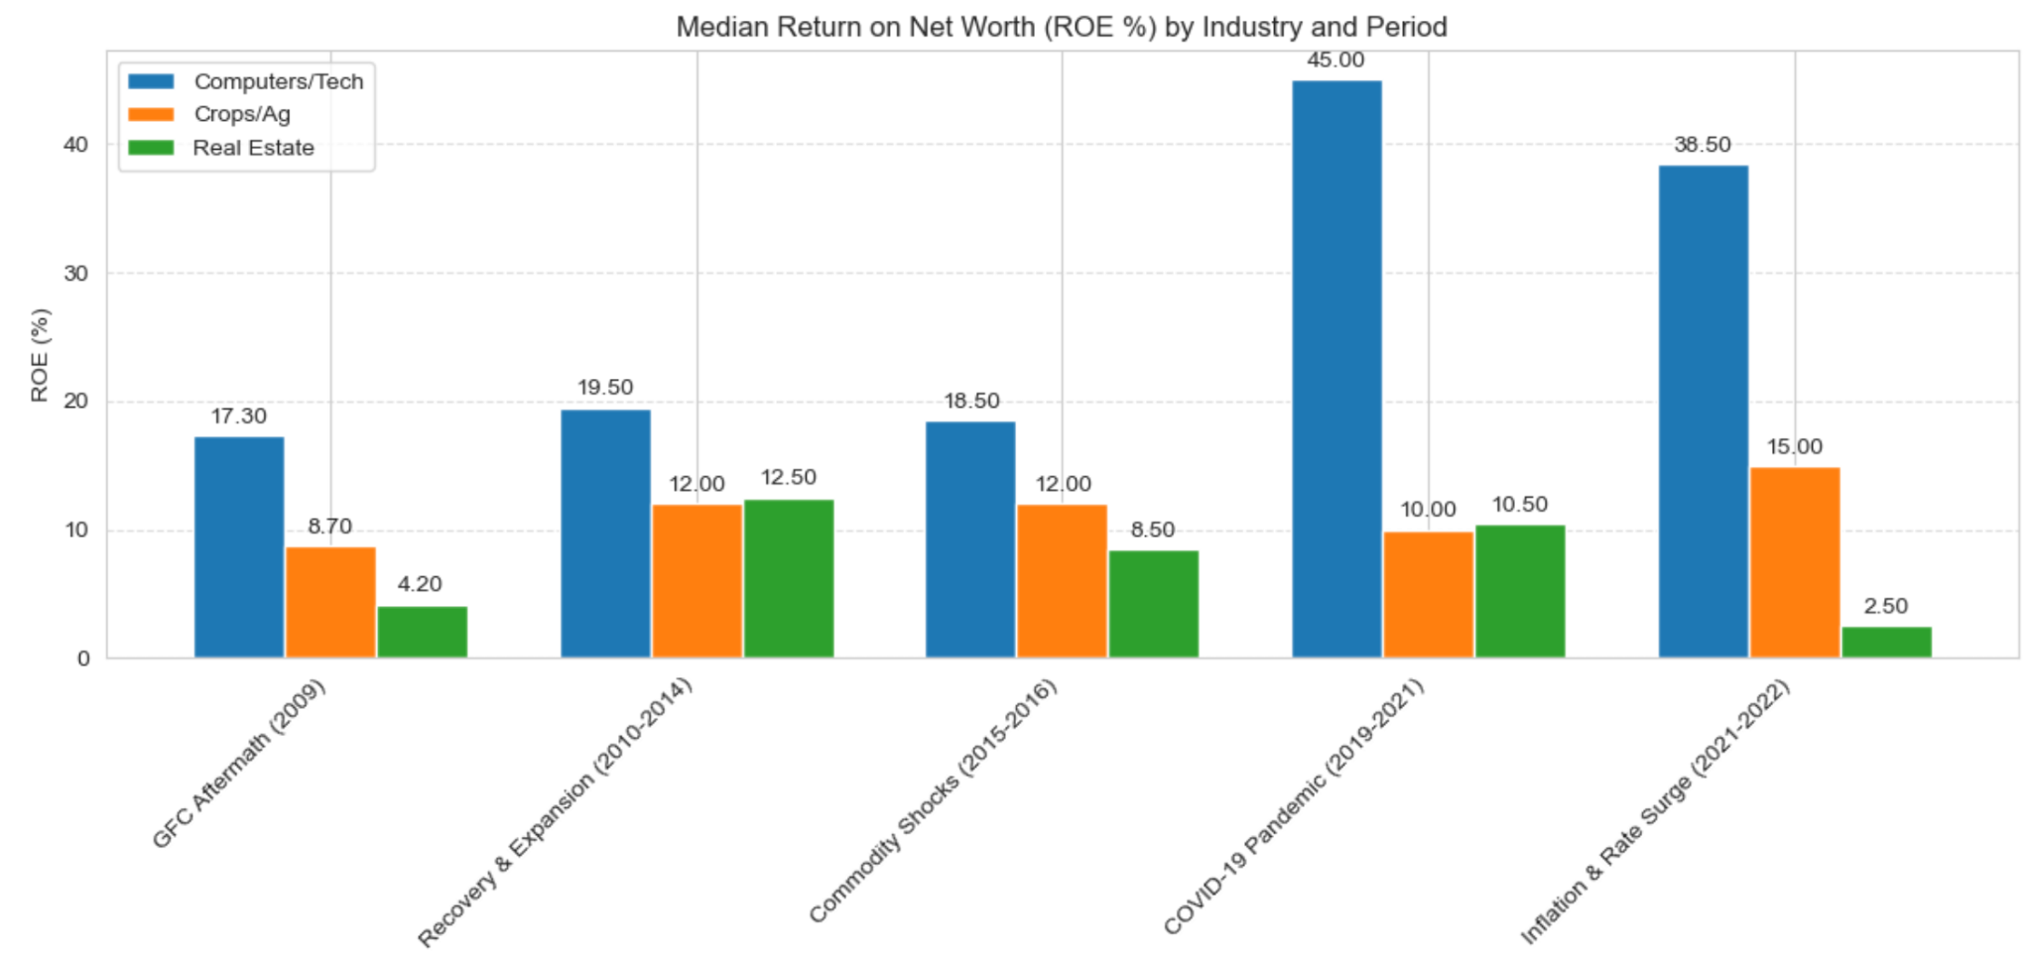
Return on Equity (ROE)

Slide 28
Conclusion
Over the entire 15-year cycle covering five major macro shocks, the Software/Computers distribution sector was the undisputed winner in every single period.
It delivered:
the safest liquidity when crises hit,
the lowest volatility in leverage,
the fastest and most consistent asset turnover,
and by far the highest risk-adjusted returns on both assets and equity.
Real Estate only led when interest rates were falling or ultra-low; Crops only looked strong in very narrow windows of high commodity prices. Tech won in the crash, the recovery, the commodity bust, the pandemic, and the rate-hike cycle, the true all-weather champion

Slide 29
Driver | Why it is the #1–#5 resilience factor
Superior Liquidity (Quick Ratio consistently >1.0, ideally >1.2) | The single strongest separator of survivors vs. casualties in every single crisis. Tech never went below 1.0; Real Estate and Crops repeatedly dipped below 0.8–0.9 and paid the price.
Low & Stable Leverage (Total Liabilities / Net Worth <150–180 % across the cycle) | Companies that kept leverage moderate and non-spiking (Tech) survived every shock. Crops and Real Estate routinely crossed 300–500 % before collapsing.
Asset-Light Business Model (Assets/Sales % <50 %, high Sales/Inventory turns) | Tech’s median Assets/Sales stayed 26–42 % → produced 2–10× higher ROA/ROE than Crops (70–150 %) or Real Estate (250–350 %). Fixed assets became traps when revenue fell.
Persistent Positive Net Margins (even 1–3 % in bad years) | Tech never went negative. Real Estate swung from +15 % to –20 % and Crops from +6 % to –50 % → negative margins instantly triggered death spirals.
Pricing Power & Fast Collections (Collection Period <45 days + ability to pass on cost increases) | Real Estate collected in ~12 days and kept margins alive longer; Tech had pricing power to protect margins even at 60-day terms. Crops had neither and suffered most in every downturn.
Revenue & Customer Diversification | Implicit in Tech’s steady ratios vs. Crops’ wild swings tied to single-commodity prices and Real Estate’s dependence on interest-rate cycles.

Slide 30
Thank You

